Slide 1
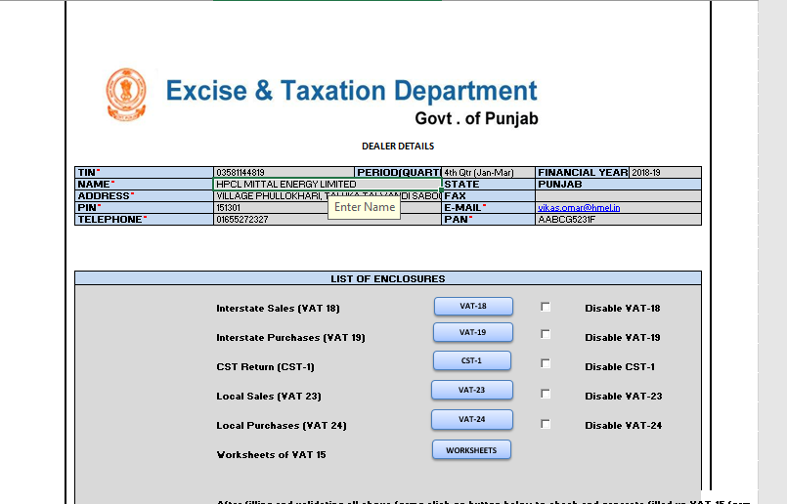
Index Sheet
In the Index Sheet, dealer details will be filed by dealer as registered under PVAT & screen shot is as under :-

Slide 2
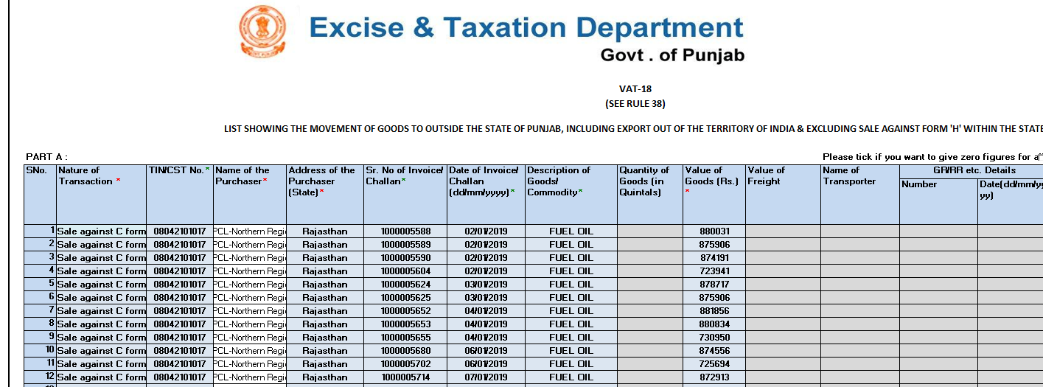
VAT-18
In the Form VAT-18 , Dealer will be filed sale of inter state & screen shot is as under:-

Slide 3
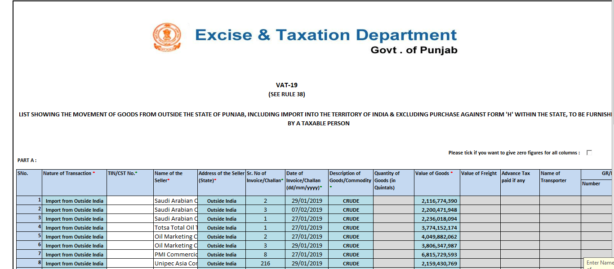
VAT-19
In the Form VAT-19 , Dealer will be filed purchase of inter state & screen shot is as under:-

Slide 4
CST Form
In the CST Form, Dealer will be filed details of CST Liability & screen shot is as under:-

Slide 5
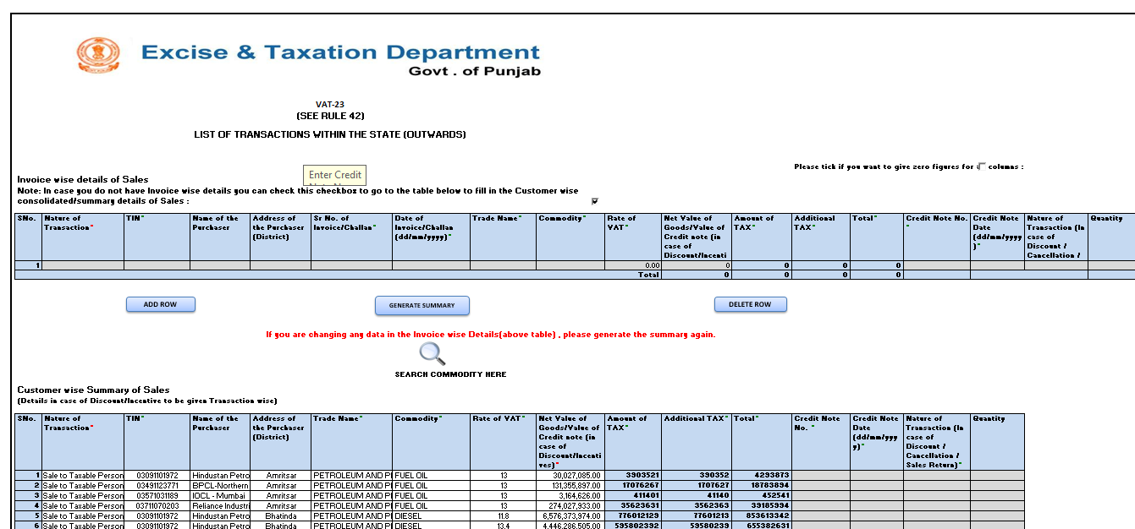
VAT-23
In the Form VAT-23 , Dealer will be filed sale of intra state & screen shot is as under:-

Slide 6
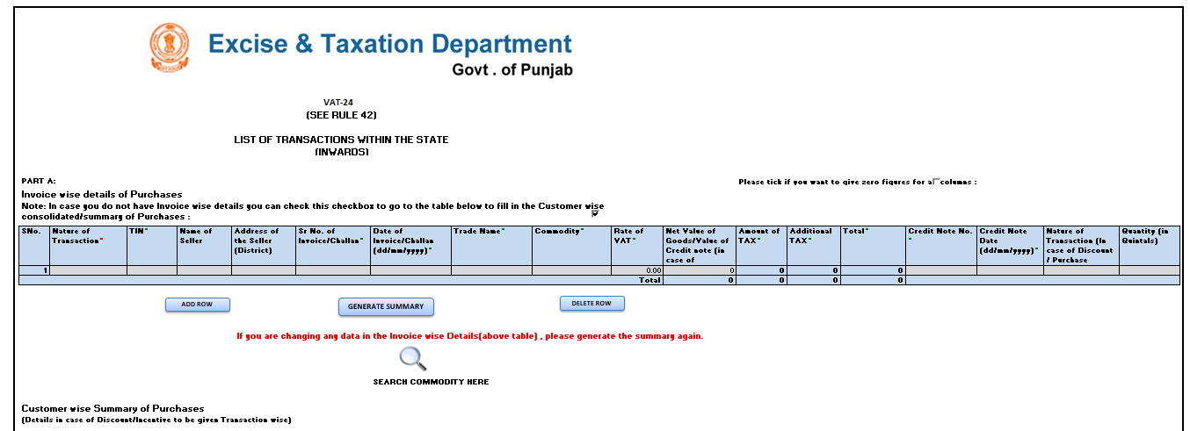
VAT-24
In the Form VAT-24 , Dealer will be filed purchase of intra state & screen shot is as under:-

Slide 7
Worksheet-4
After coming the GST , no information will be required to file in Worksheet No. 1, 2 & 3 & only details will be filed in worksheet no. 4, 5, & 6. Screen shot of worksheet no.4 is as under:-

Slide 8
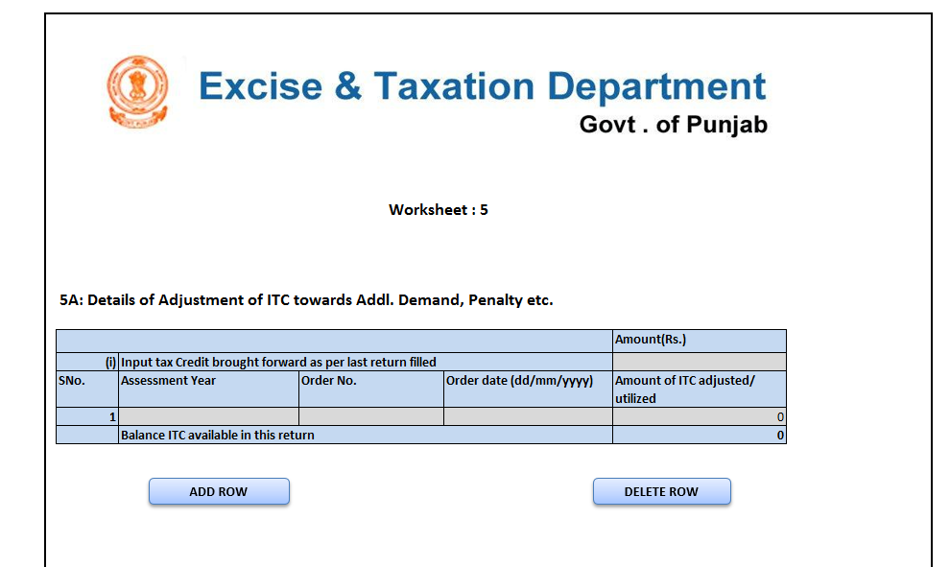
Worksheet-5
After coming the GST , no information will be required to file in Worksheet No. 1, 2 & 3 & only details will be filed in worksheet no. 4, 5, & 6. Screen shot of worksheet no.5 is as under:-

Slide 9
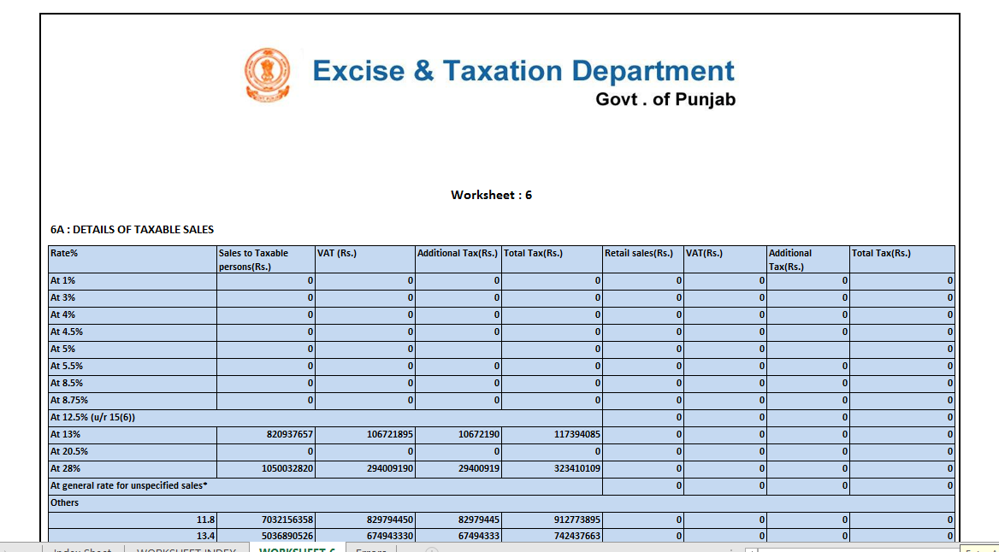
Worksheet-6
After coming the GST , no information will be required to file in Worksheet No. 1, 2 & 3 & only details will be filed in worksheet no. 4, 5, & 6. Screen shot of worksheet no.6 is as under:-

Slide 10
Thank you

